Slide 1

Social Science Research Design and Statistics, 2/e Alfred P. Rovai, Jason D. Baker, and Michael K. Ponton
Internal Consistency Reliability Analysis
PowerPoint Prepared by Alfred P. Rovai
IBM® SPSS® Screen Prints Courtesy of International Business Machines Corporation,
© International Business Machines Corporation.

Slide 2
Uses of Internal Consistency Reliability Analysis
Quality research must come from measures that have the ability to consistently (i.e., reliably) and accurately detect changes in research participants’ skills, knowledge, attitudes, or behavior.
A reliable measure is reproducible and precise: each time it is used it produces the same results, all else being equal.
Internal consistency reliability analysis is a parametric procedure used to evaluate the consistency of results across items within a single scale (i.e., instrument) or subscale that is composed of multiple items.
All items in an internally consistent scale assess the same construct.

Slide 3
Uses of Internal Consistency Reliability Analysis
The following models of internal consistency reliability are available in SPSS:
Cronbach’s alpha model is based on the average inter-item correlation. It is used when items are not scored dichotomously, e.g., it is used for multiple choice items.
Split-half model splits the scale into two parts and examines the correlation between the parts.
Guttman model computes Guttman’s lower bounds for true reliability.
Parallel model assumes that all items have equal variances and equal error variances across replications.
Strict parallel model makes the assumptions of the parallel model and also assumes equal means across items.
Each model involves administering the instrument once to a single group of subjects and yields a reliability coefficient (also known as the coefficient of internal consistency).

Slide 4
Uses of Internal Consistency Reliability Analysis
Procedures for estimating reliability produce a reliability coefficient, which is a correlation coefficient that ranges in value from zero to + 1.0. When a reliability coefficient is zero, all variability in obtained test scores is due to measurement error. Conversely, when a reliability coefficient is 1.0, all variability in scores reflects true score variability.
Reliability coefficients can be interpreted as follows:
Very high reliability = .90 and above
High reliability = .70 to < .90
Moderate reliability = .50 to < .70
Low reliability = .30 to < .50
Little if any reliability < .30
Note: many social science researchers consider scale reliability below .70 as questionable and avoid using such scales.
A reliability coefficient is never squared to interpret it, as is the case with other correlation coefficients, but is interpreted directly as a measure of true score variability. A reliability coefficient of .70 means that 49% of variability in obtained scores is true score variability.

Slide 5
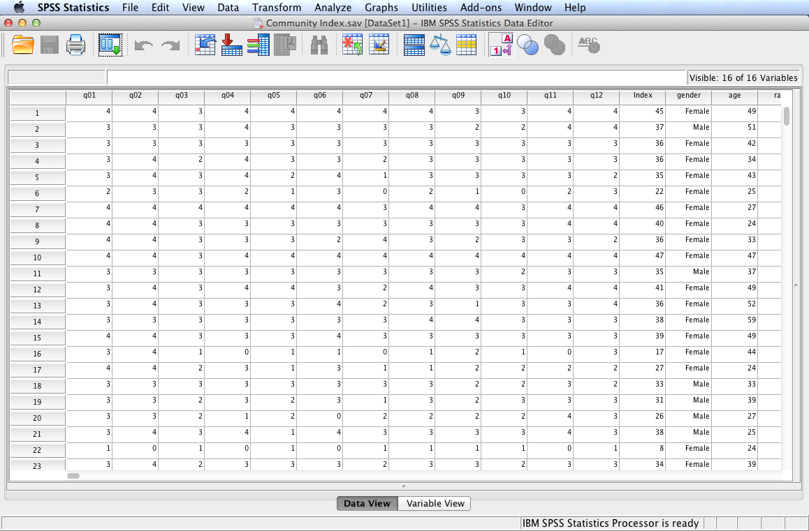
Open the dataset Community Index.sav.
File available at http://www.watertreepress.com/stats

Slide 6
Sense of Classroom Community Index
The internal consistency reliability of the following instrument is analyzed in this presentation:
Each item has the following response set: Strongly Agree (SA), Agree (A), Neutral (N), Disagree (D), Strongly Disagree (SD)
I feel that students in this course care about each other
I feel that I am encouraged to ask questions
I feel connected to others in this course
I feel that it is hard to get help when I have a question
I do not feel a spirit of community
I feel that I receive timely feedback
I feel that this course is like a family
I feel isolated in this course
I feel that I can rely on others in this course
I feel uncertain about others in this course
I feel that my educational needs are not being met
I feel confident that others will support me
Items are scored as follows: SA = 4, A = 3, N = 2, D = 1, SD = 0. To obtain the overall Classroom Community Index score, one must add the weights of all 12 items. Total raw scores range from a maximum of 48 to a minimum of 0. Items 4, 5, 8, 10, and 11 are reversed scored.

Slide 7
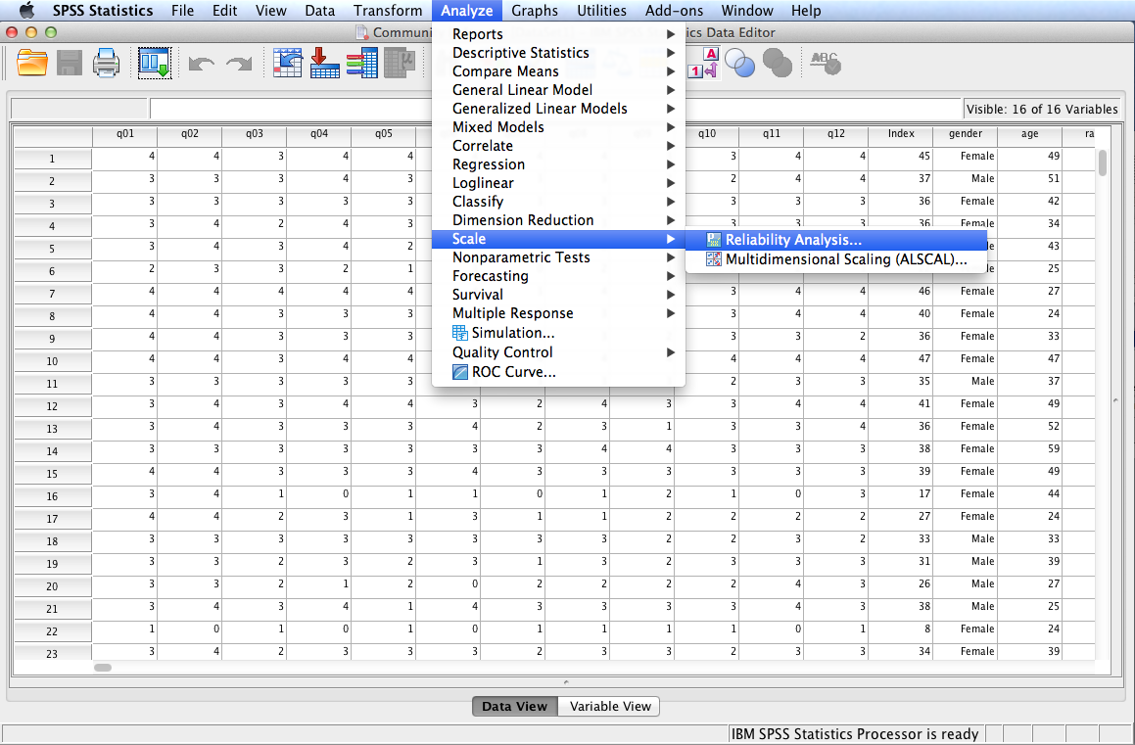
Follow the menu as indicated.

Slide 8
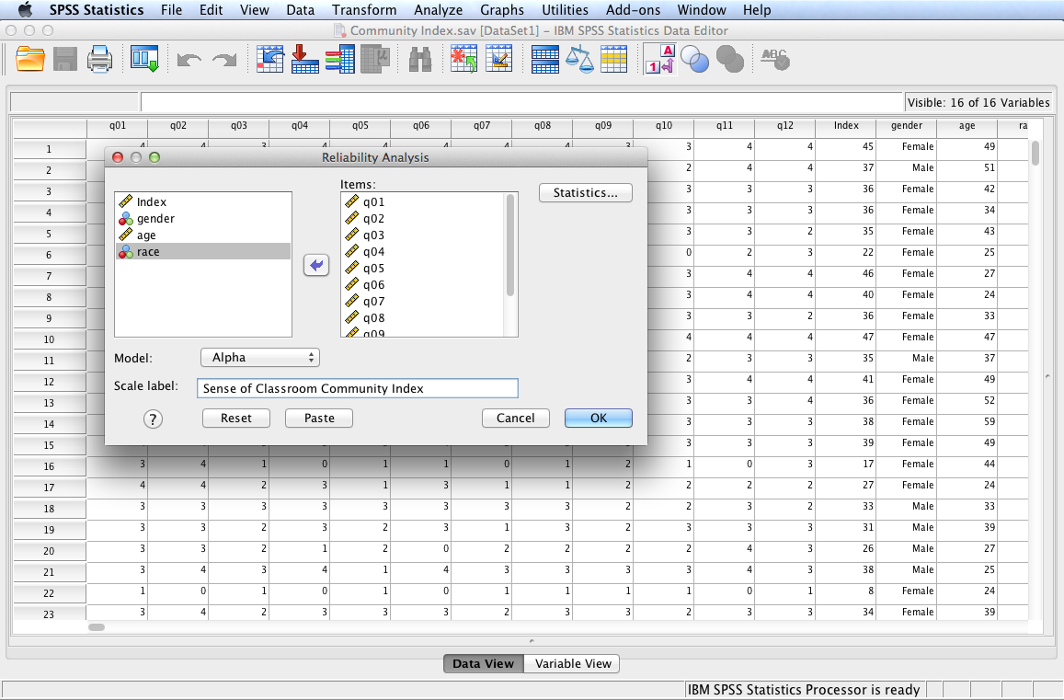
In this example, we will test the following null hypothesis:
H_{o}: The Sense of Classroom Community Index is not reliable, r < .70.
Select and move variables q01 through q12 to the Items: box. Retain Alpha (i.e., Cronbach’s alpha) as the model. Enter Sense of Classroom Community Index (the name of the 12-item instrument administered to subjects) as the Scale Label. Finally, click Statistics....

Slide 9
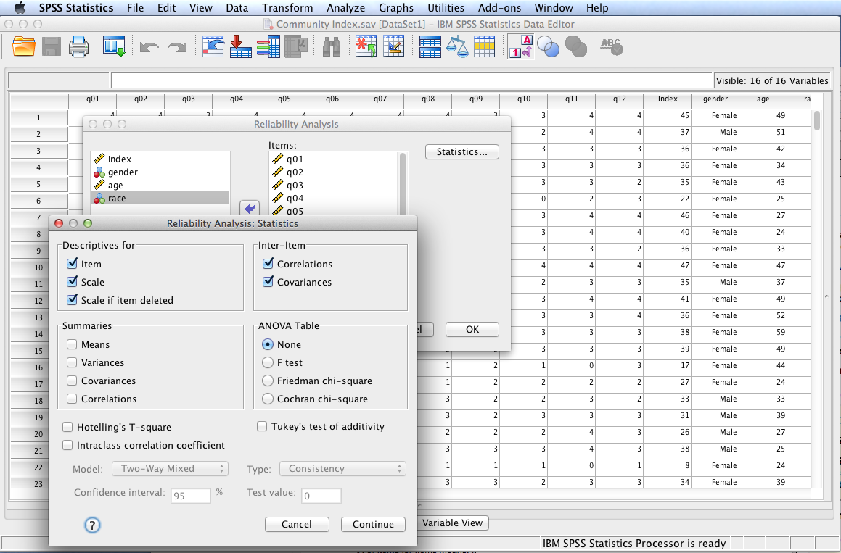
Check the items as shown in the Statistics dialog to the left. Click Continue and then OK to run the procedure.

Slide 10
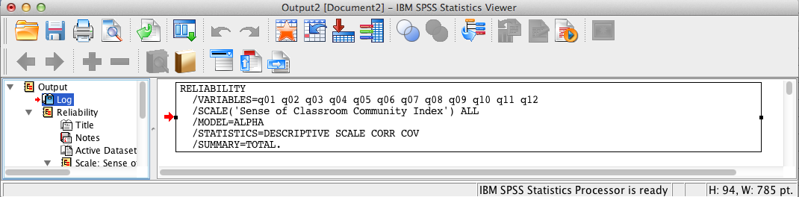
SPSS Output
The contents of the SPSS Log is the first output entry. The Log reflects the syntax used by SPSS to generate the Reliability output.

Slide 11
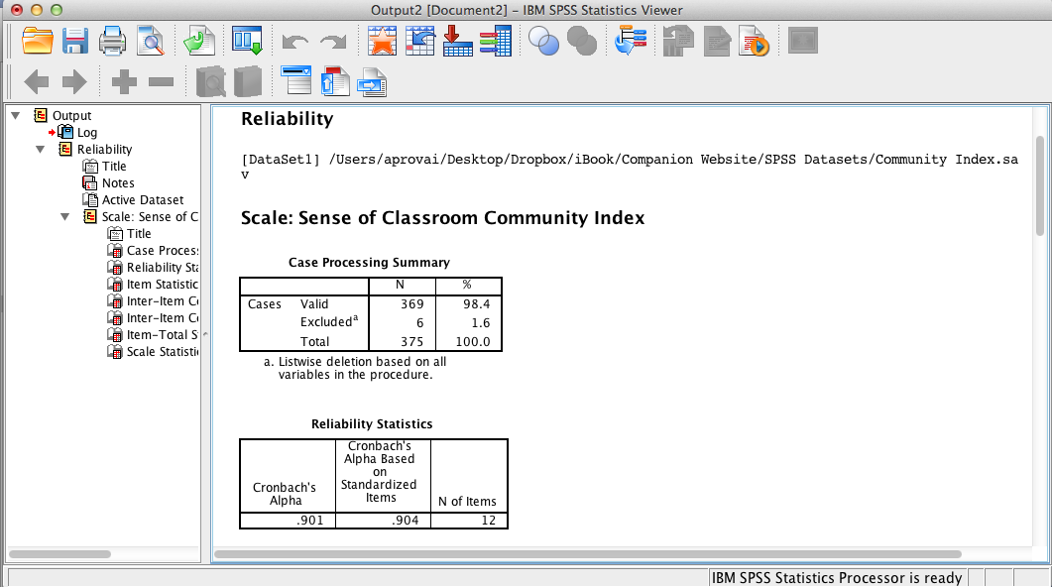
SPSS Output
Reliability output includes the Case Processing Summary and the Reliability Statistics. The instrument’s internal consistency as measured by Cronbach’s alpha is very high (i.e., .90).
Note: the standardized item alpha is only used when all scale items have been standardized because individual scale items are not scaled the same (not the case here).

Slide 12
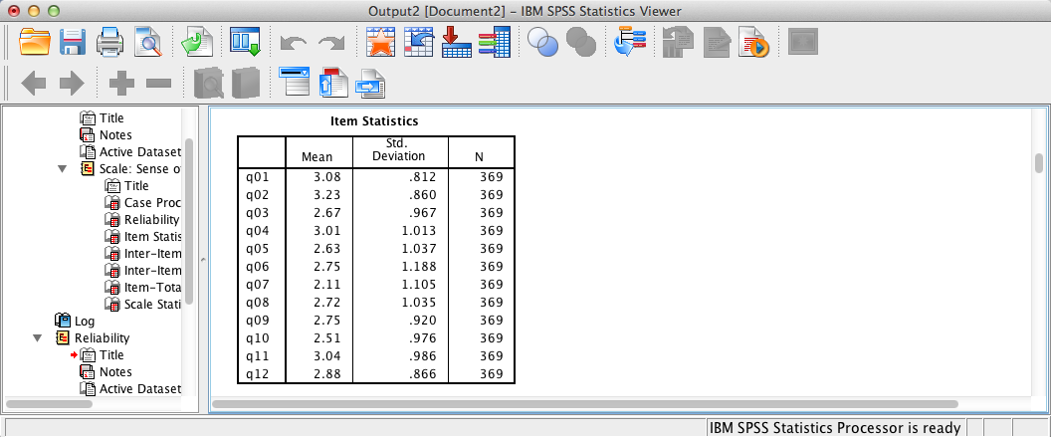
SPSS Output
The next table provides descriptive statistics for each item on the scale.

Slide 13
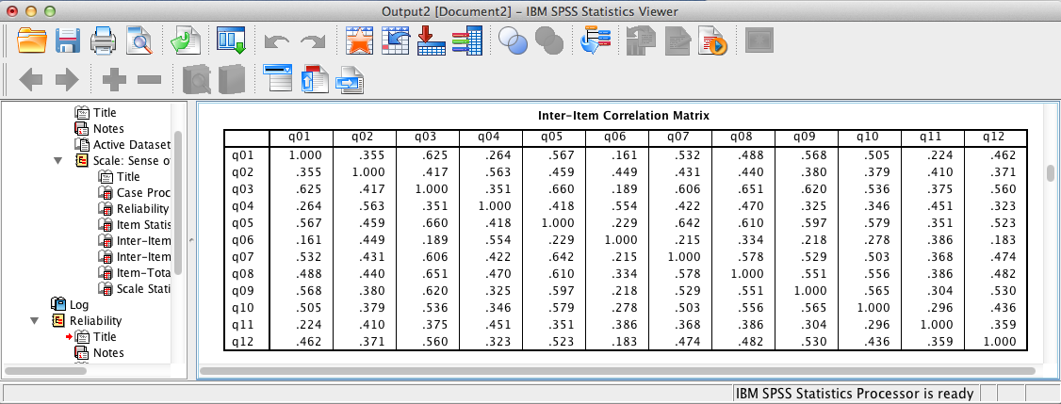
SPSS Output
This table displays inter-item correlations.

Slide 14
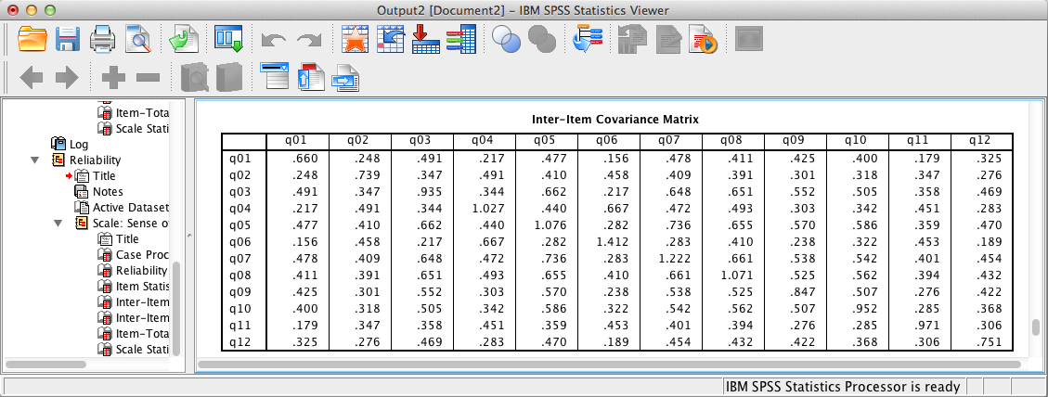
SPSS Output
This table displays inter-item covariances.

Slide 15
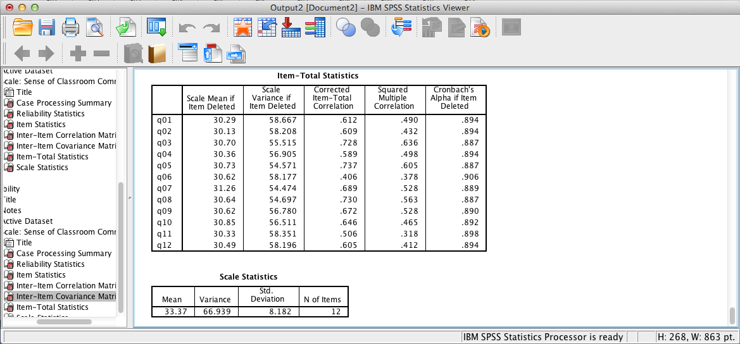
SPSS Output
These final two tables display summary statistics for each item, if deleted, as well as scale statistics.
One must be careful about deleting an item in order to increase scale reliability as such action may reduce the validity of the instrument.

Slide 16
Internal Consistency Reliability Results Summary
H₀: The Sense of Classroom Community Index is not reliable, r < .70. The present analysis, which used the Sense of Classroom Community Index to operationalize classroom community, confirms the high internal consistency reliability of this instrument, Cronbach’s alpha = .90. Consequently, there is sufficient evidence to reject the null hypotheses and conclude that the Sense of Classroom Community Index is an internally consistent instrument.

Slide 17
End of Presentation

